Slide 1
Cancer Disease Prediction
Group 1 Mid Term Assignment
Aarushi Pandey, Karthikeyan Mohan, Robin Chabra, Yugandhar Kumar Savalam

Slide 2
Table of contents
Introduction
Approach
EDA
One Hot Encoding
Elbow Method
Silhouette Method
K Means Algorithm
Cluster Analysis

Slide 3
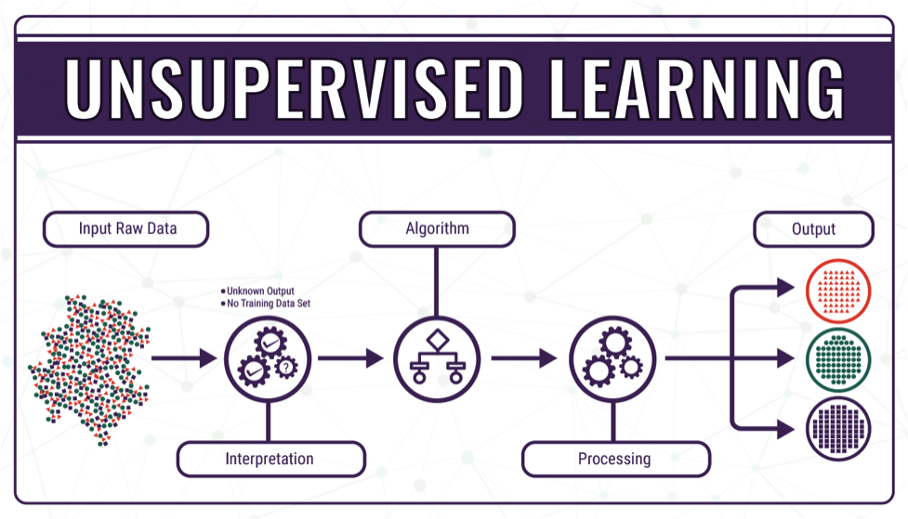
Introduction
The cancer dataset we used for K-means model contains nine independent variables column values range between (1-10 integers) and one dependent variable (Class - 2 for benign, 4 for malignant ).
We need to build the unsupervised machine learning model using K-Means clustering method.
This Photo by Unknown Author is licensed under CC BY-SA

Slide 4
Approach :
Import and read the dataset
Analyze the data using the Pandas Profiling library.
Data Cleaning using pandas and NumPy to remove null and special characters in the dataset if any.
Perform one hot encoding to normalize the dataset.
Find the K-Value using the Elbow method.
Evaluates the K-Value using the silhouette method.
Cluster the dataset using the K-Means clustering technique.
Evaluates the predicted cluster with the actual target value.

Slide 5
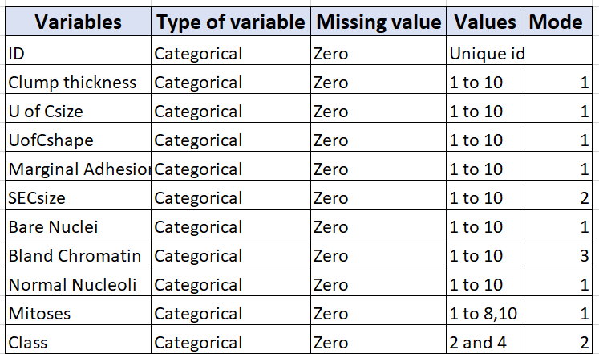
Exploratory Data Analysis
Explore and analyze the shape and understand the data.
Initially, we import necessary libraries like NumPy, Pandas, Scikit Learn and Matplotlib and read the file and used pandas profiling to do the EDA.

Slide 6
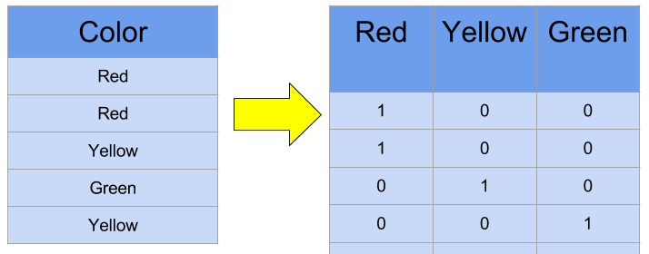
One Hot Encoding
It is a representation of categorical variables as binary vectors.
This first requires that the categorical values be mapped to integer values and allows the representation of categorical data to be more expressive.
Initially , In this model we have 10 columns after using one hot coding, the no. of column changes to 89.
The one hot encoder sorts each variable's data into new columns based on similar values of data.(Ranges 1-10).
For example: In clump Thickness column there are 10 new columns based on common values generated after using one hot encoder (Range 1-10).
Similarly, in 8 variable the data is classified to 10 new columns and 9 new columns in one variable. This resulted into 89 new columns.
This Photo by Unknown Author is licensed under CC BY-SA

Slide 7
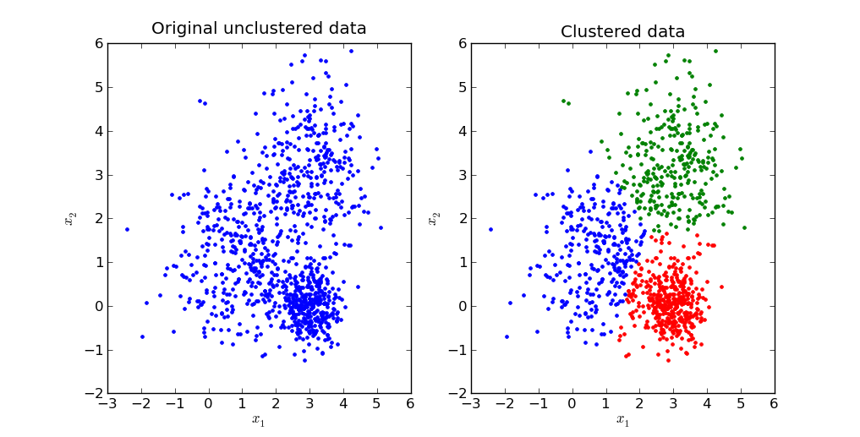
K Means Cluster
Identify the number of cluster we want which is K Value or Centroid.(Elbow method - Find wess value which shows minimum change)
Randomly select the K value.
Measure the distance between data points and the K values, group them into clusters based on the distance(use Euclidean distance),then find the mean.
Change the K value to mean and cluster again until group doesn't change after changing K value with mean.
This Photo by Unknown Author is licensed under CC BY-SA

Slide 8
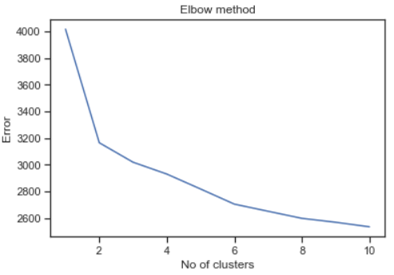
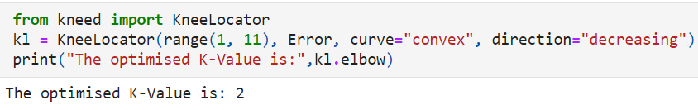
Elbow Method
It is used to determine the optimal value of k.
It involves running the k means algorithm multiple times over a loop.
We drew error vs no. of clusters graph and got k=2 as the optimal value.
The line chart looks like an arm and because the "elbow" on the arm is forming at k=2, we chose 2 as K Value
This k=2 is validated by our target variable which is 2 for benign and 4 for malignant.

Slide 9
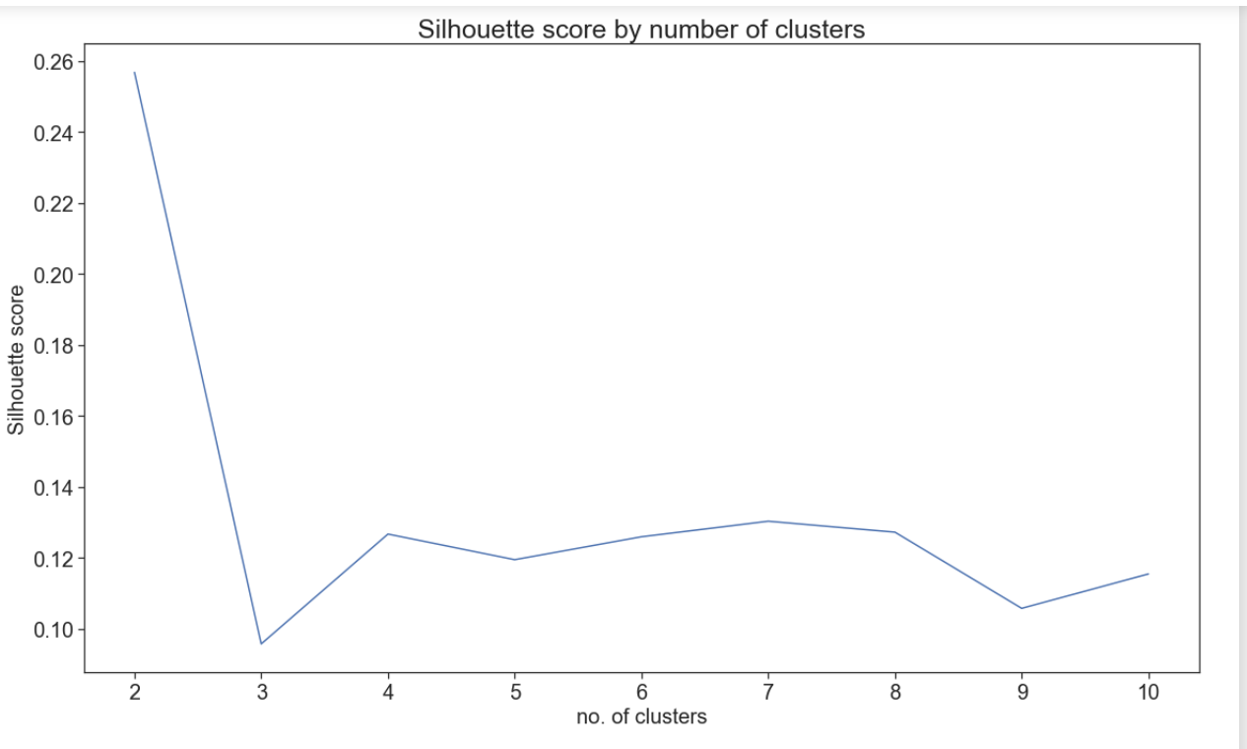
Silhouette Method
To validate the number of clusters we got in elbow method, silhouette method is used.
Silhouette score was calculated using the formula : Silhouette Coefficient = (x-y)/ max(x,y)
We plotted Silhouette score vs no. of clusters graph and the silhouette score with k=2 was the maximum.
This confirms k=2 in the elbow method and our target variable in the dataset.

Slide 10
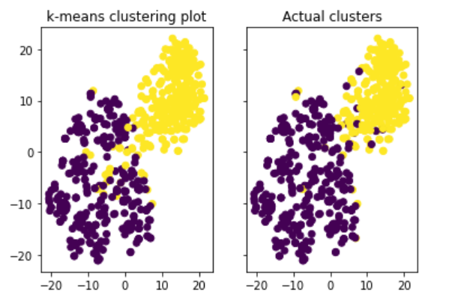
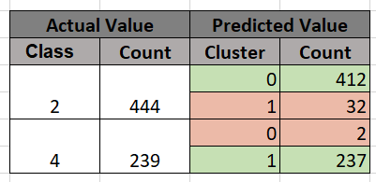
Visualizing the cluster
Plotted the graph with actual target and made the cluster
Plotted the graph with predicted value and made the cluster.
There are few differences in both the clusters.
To see the number of difference, wrote a program to see the numbers.

Slide 11

This Photo by Unknown Author is licensed under CC BY

